Slide 1

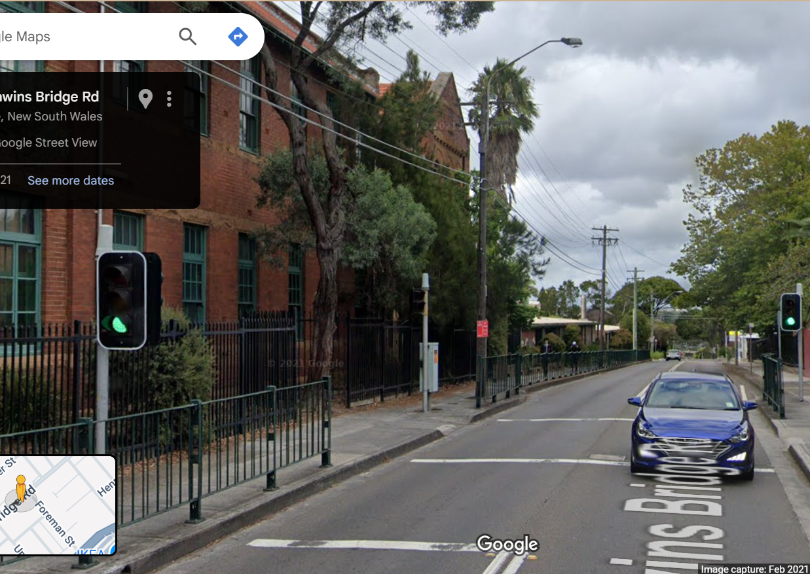

Pi Pico OOP Mini Project
Ben Jones
Tempe High School
Lecture 1
Notes:
This lecture focuses on the fundamental concepts of the Object Oriented Paradigm

Slide 2
Today
Unit Testing
UML (Unified Modelling Language)
Generalisation
Bottom up
Super/Sub Class
Pin & PWM Super Classes
Instantiation
Inheritance
Notes:
Today we will cover
Unit Testing
UML (Unified Modelling Language)
Generalisation
Bottom-up approach to Object Oriented Programming
Super/Sub Class relationship also called the Parent/Child
Introduce the Pin & PWM Super Classes
Instantiation and Inheritance

Slide 3
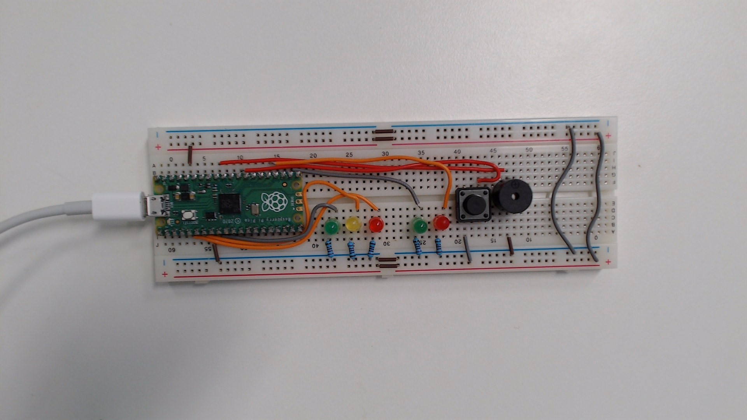
Unit Testing
Testing method where individual components are tested in isolation to verify their correctness.
By ensuring each component works independently, you can confidently build more complex mechatronic solutions.
Classes
Functions or methods
Components
Wires
Wiring
Notes:
Unit testing is an approach where individual components of software or hardware are tested in isolation to verify that they function as expected. By ensuring each component works correctly on its own, you can confidently build more complex solutions.

Slide 4
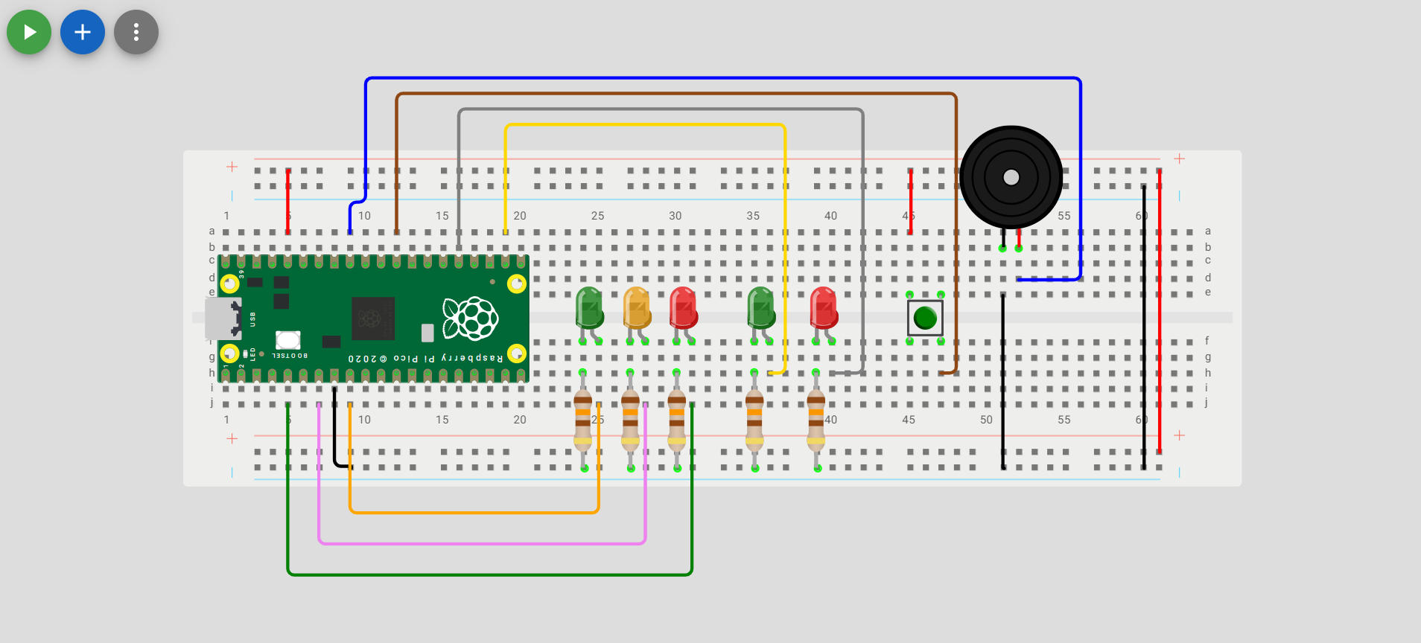
Wokwi Prototype
Unit Tests
All 5 LEDs should illuminate.
The buzzer should emit animated musical note on screen and if volume is turned up a constant tone.
The momentary switch should return `1` to the IDE terminal when closed (pressed) and 0 when not closed (depressed).
Hardware unit test is v02.py
Notes:
Use the code provided in v02.py to unit test your Wokwi prototype. The expected outcomes of your test are:
All 5 LEDs illuminate.
The buzzer beeps.
The button returns a value of 1 to the terminal when pressed.
Ensure each of these outcomes occurs as you run the unit test to confirm your prototype is working correctly.

Slide 5
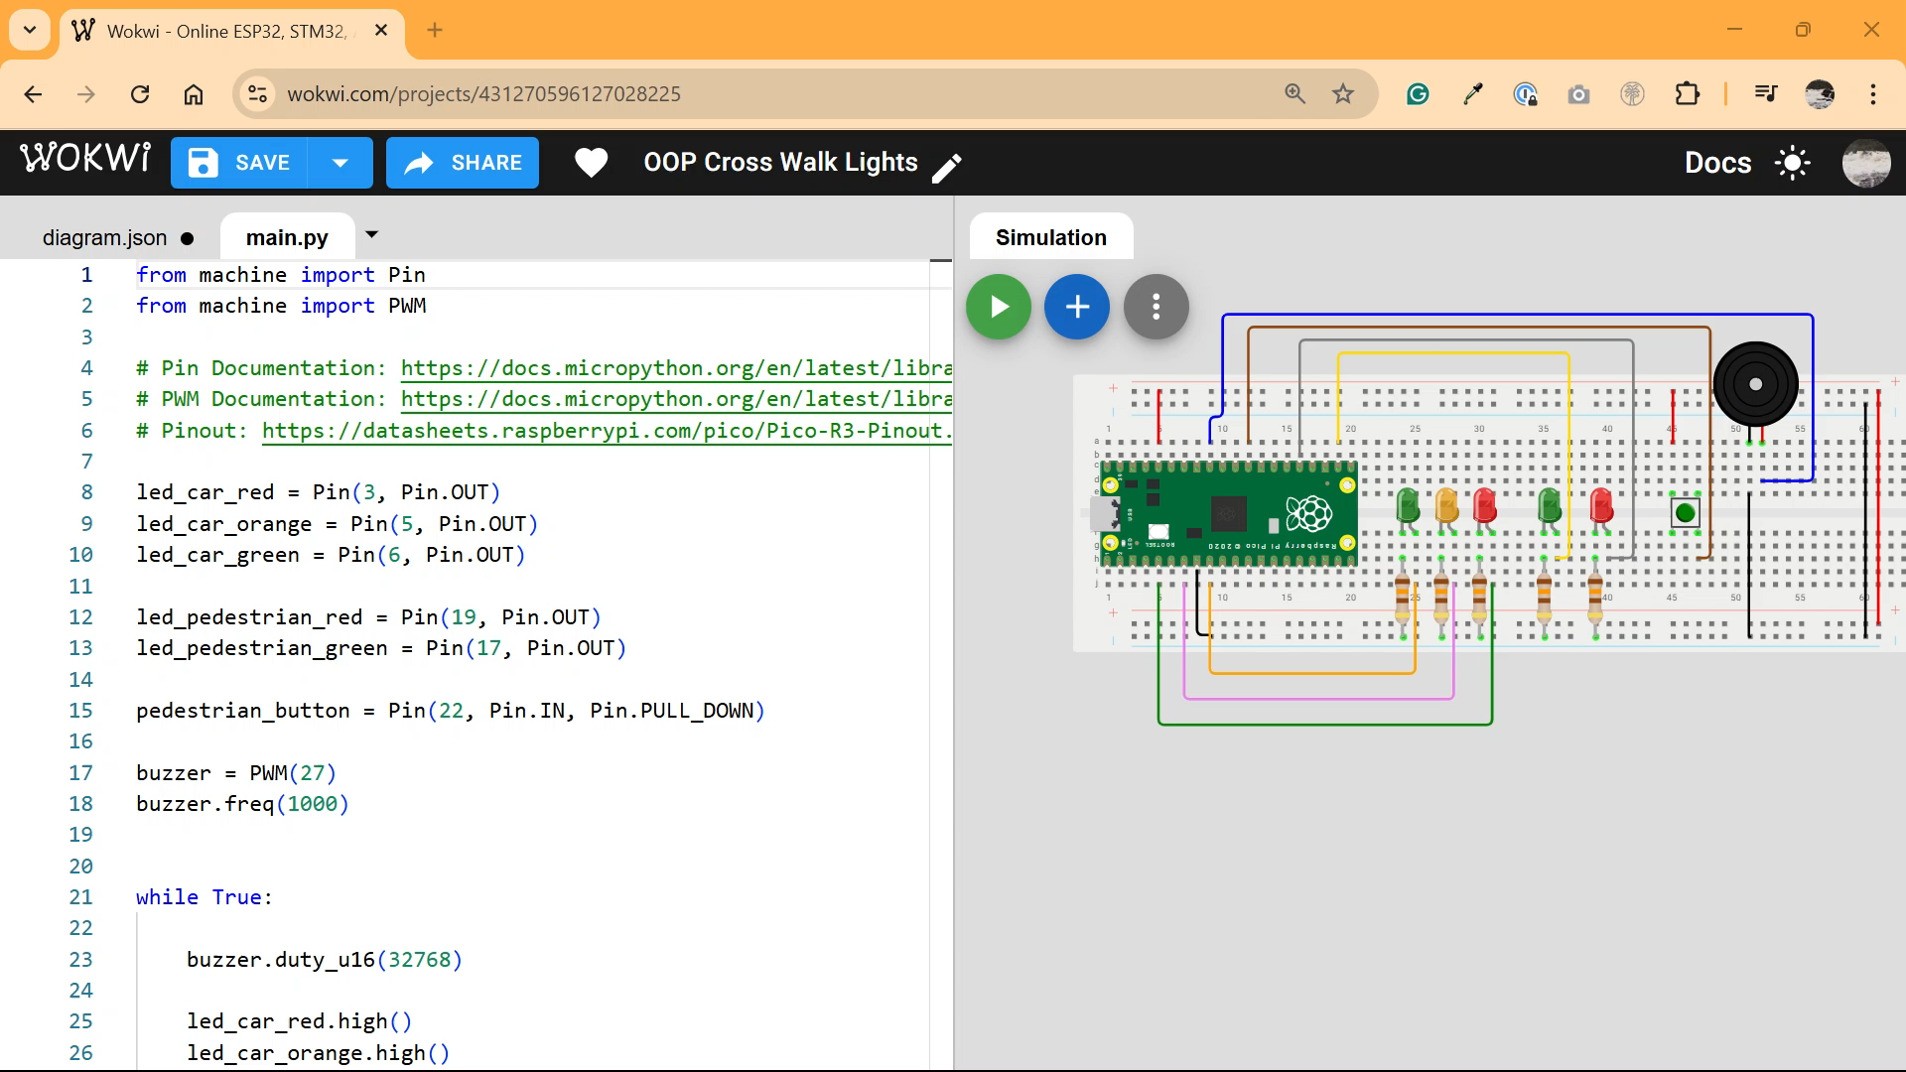

Slide 6

Physical Prototype
Unit Tests
All 5 LEDs should illuminate.
The buzzer should emit a constant tone.
The momentary switch should return `1` to the IDE terminal when closed (pressed) and 0 when not closed (depressed).
Hardware unit test is v02.py
Notes:
If you have physically wired a breadboard, use the code in v02.py to unit test your setup in VSCode. Connect to your Pi Pico and run the script using the command 'Run Current File on Pico'.
The expected outcomes of your test are:
All 5 LEDs illuminate.
The buzzer beeps.
The button returns a value of 1 to the terminal when pressed.
Ensure each of these outcomes occurs as you run the unit test to confirm your prototype is working correctly.

Slide 7
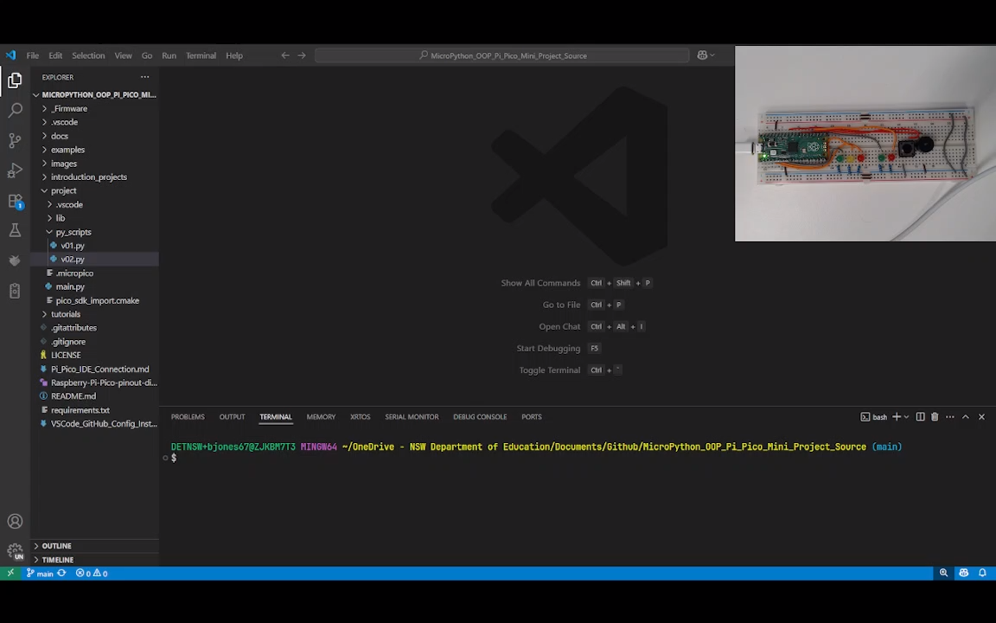

Slide 8
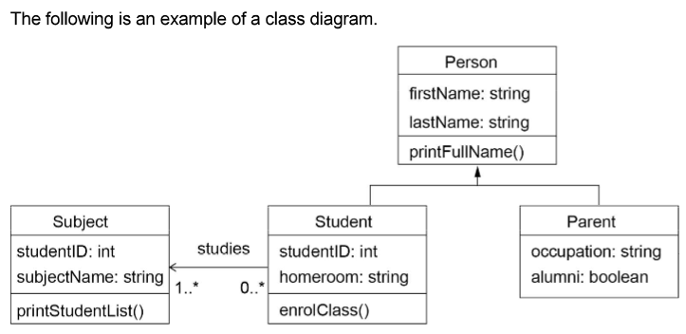
UML
Class Name (Top Section): This is the uppermost part of the box. It displays the name of the class (e.g., Student, Order, Car).
Attributes (Middle Section): This section lists the attributes (or properties/fields) of the class. Each attribute is typically shown with its visibility (+ for public, - for private, # for protected), name, and type.
Methods (Bottom Section): This section lists the methods (or operations/functions) that belong to the class. Each method is shown with its visibility, name, parameters, and return type.
Connections (lines and arrows): These lines and arrows represent relationships (such as inheritance, association, aggregation, and composition) between class boxes.
Notes:
We use UML diagrams to model classes and their relationships. The diagram on the right comes from the course specifications, which clearly outline the requirements for UML in this course. You should become very familiar with both the requirements and the specification.
In a UML class diagram:
The top box contains the class name.
The middle box lists the attributes of the class, including their types.
The bottom box contains the methods of the class.
The connecting lines and arrows indicate relationships between classes, such as inheritance or association. We will learn about these relationships and how to apply them to our project in the upcoming lectures.

Slide 9
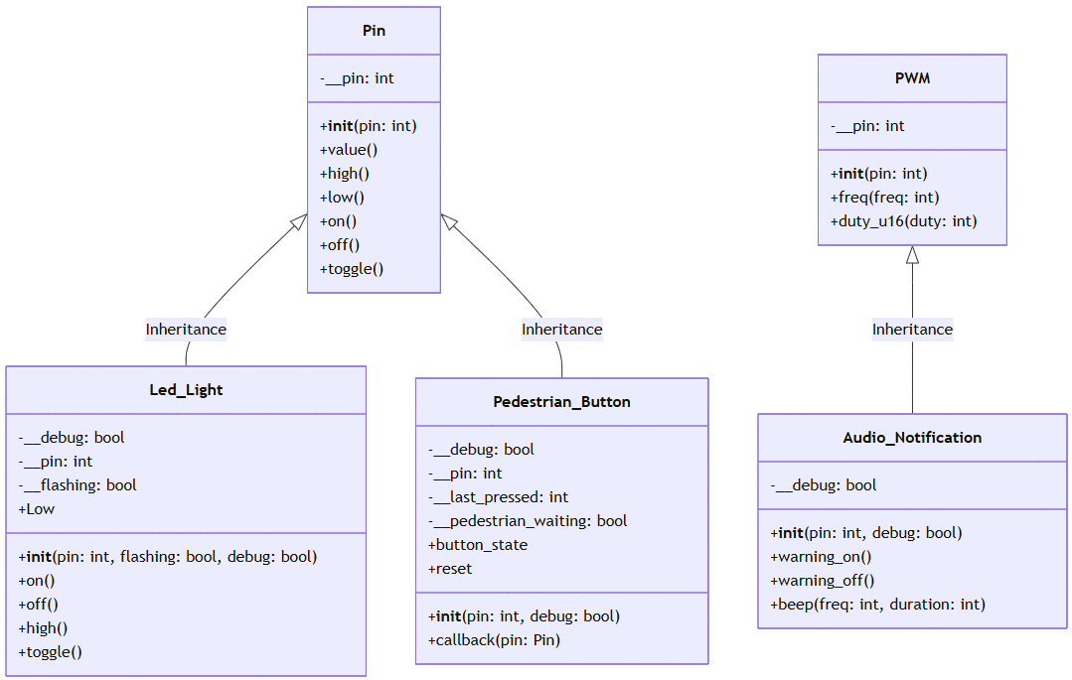
Generalisation
The process of identifying patterns or commonalities among specific examples or cases and formulating a broad class that can be applied to all instances.
On the Pi Pico, the Pin and PWM libraries are designed generalised providing a flexible and reusable interfaces for interacting with the microcontroller’s hardware. The simple on(), off() or high(), low() methods are not specific to any hardware but are generalised to the nature of a digital GPIO Pin.
Notes:
Generalisation in object-oriented programming involves creating a broad, general class that captures shared features or behaviors, allowing more specific classes to inherit from it. On the Pi Pico, the Pin and PWM libraries are examples of generalisation—they provide flexible and reusable interfaces for interacting with the microcontroller’s hardware. Methods like on(), off(), high(), and low() are not tailored to any specific hardware, but are generalised to represent the fundamental behavior of a digital GPIO pin.

Slide 10
Super/Sub Class
The Super Class defines common attributes and methods that can be shared by its Sub Classes, promoting code reuse and organisation.
The Sub Class inherits (a concept we will next cover) the generalised Super Class and extends it, providing more specific functionality.
In MicroPython Super Classes Pin & PWM are more the most generalised classes which define common attributes and methods that will be used by the less generalised Sub Classes that we will implement.
Notes:
The terms Super/Sub or Parent/Child refer to the hierarchical relationship between classes. The Super Class (or Parent Class) is more generalised, while the Sub Class (or Child Class) inherits behaviours from the Super Class and then extends or specialises them for a particular design problem or hardware. It’s important to remember that Parent/Child and Super/Sub are interchangeable pairs, but they are always used together. We do not mix the terms, such as using Parent/Sub or Super/Child.

Slide 11
Bottom Up Development
A common development pattern in OOP, the ‘Bottom up’ approach, which involves developing the generalised Super Classes first. Then, developing the more specific Sub Classes up towards the full system. When you are looking at UML diagrams, the bottom is actually the top of the diagram.
Notes:
A common development pattern in object-oriented programming is the ‘bottom-up’ approach, where you start by developing the generalised Super Classes first, followed by the more specific Sub Classes, gradually building up to the complete system. Interestingly, in UML diagrams, what is referred to as the ‘bottom’ in this approach actually appears at the top of the diagram. For this task, we will use the bottom-up approach, which is generally preferred in object-oriented programming.

Slide 12
Super Class Documentation
Machine.Pin Library
Machine.PWM Library
The Pin library in MicroPython for the Pi Pico allows you to control the General Purpose Input/Output (GPIO) pins of the Pico. It allows you to configure pins as digital (binary) inputs or outputs.
The PWM Library provides an interface for controlling PWM signals on a specified GPIO pin. It allows you to configure any GPIO pin as a PWM and set the duty cycle and frequency.
Notes:
In this project we will use the generalised Classes Pin and PWM. Let’s look at the documentation for both of them.

Slide 13
Notes:
You should review the MicroPython documentation to become familiar with the class attributes and methods, including the initializer method and any other methods we will be using. Such as value, on, off, high, low and toggle.

Slide 14
Instantiation
Instantiation is a fundamental concept in object-oriented programming (OOP). A class is like a blueprint for an object, it defines the attributes and methods the object will have, but it isn’t an actual object itself.
Instantiation is the process of creating a copy of the class structure that will be a real, usable object in memory.
Notes:
Instantiation is the process of using a class to create a real, usable object in memory. This process allocates a unique namespace for the new instance, allowing you to access its attributes and methods independently from other objects.

Slide 15
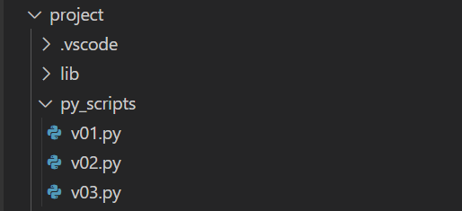
Create a v03.py in project\py_scripts\
We will use this py_script to demonstrate some core OOP principles and then develop our first more specific Sub Class for a led light in our traffic light controller.
Notes:
Create v03 .py in py scripts where you will instantiate some instances of the Pin Class.

Slide 16

Instantiation
from machine import Pin
from time import sleep
led_car_red = Pin(3, Pin.OUT)
led_car_orange = Pin(5, Pin.OUT)
led_car_green = Pin(6, Pin.OUT)
while True:
led_car_red.toggle()
led_car_orange.toggle()
led_car_green.toggle()
sleep(1)
Notes:
Pause this video and implement the required code in v03.py. Next, I will demonstrate how to execute your code on the Pi Pico.

Slide 18
Inheritance
Inheritance is a fundamental concept in object-oriented programming (OOP). It allows a class (called Sub Class) to inherit properties and behaviours (methods and attributes) from another class (called a Super Class).
In this case, the Led_Light Class inherits the Pin Class, and without any further instructions, the Sub Class inherits and can call all the methods of the Super Class, including on(), off(), high(), low(), toggle(), etc.
Notes:
Inheritance allows a Sub Class to take on the attributes and methods of its Super Class. For example, the Led_Light class can inherit from the Pin class, which means that, without any additional code, the Led_Light class can use all the methods of the Pin class—such as on(), off(), high(), low(), toggle(), and others.
It's important to understand that when inheritance occurs and an object is instantiated, a copy of the Super Class is made in memory for that specific instance. From that point on, any modifications happen in the Sub Class's namespace, leaving the original Base Class blueprint unchanged.

Slide 19
Inheritance
from machine import Pin
from time import sleep
class Led_Light(Pin):
def __init__(self, pin):
super().__init__(pin, Pin.OUT)
red_light = Led_Light(3)
while True:
red_light.toggle()
sleep(1)
Notes:
Replace the instantiation code you wrote in v03.py with this code. This code defines the Led_Light Class and defines an initializing method that calls the initialer of the Pin Super Class.

Slide 20
Notes:
As you can see, we have defined a new class named Led_Light that inherits from the Pin class. We then instantiated an object called Red_light using the Led_Light Class. From the Red_light namespace, we can access the toggle method inherited from the superclass, even though we have not implemented it in the Led_Light subclass. This demonstrates how inheritance allows sub classes to use methods from their super classes without additional code.

